Slide 1
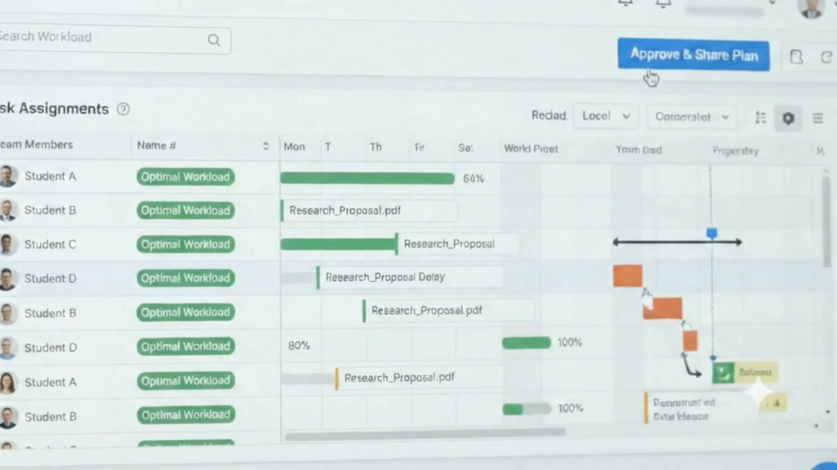
0:00–0:20

Slide 2
Intelligent Project Management System for Undergraduate Students
PP2 Progress Presentation
Integrated intelligent decision support platform for undergraduate research projects
from team formation and planning to proposal quality and risk monitoring.
1
2
3
4
Intelligent Team Formation &
Topic Feasibility
Adaptive Scheduling &
Project Planning
Quality Assessment &
Adaptive Mentorship
Risk Monitoring &
Contribution Analytics
Goal: Make project decisions earlier, more transparent, and more evidence-driven while keeping academic staff in control.

Slide 3
Problem & Stakeholders
Undergraduate project management is fragmented, manual, and often reactive.
Team formation
Planning & scheduling
Proposal quality
Risk & contribution
Staff must balance project technical needs with student preferences across many possible allocations.
Supervisors manually translate proposals into tasks, balance workloads, and resolve academic-event conflicts.
Proposal weaknesses, missing sections, and improvement needs may be identified late or inconsistently.
Project risk and free-riding can remain hidden until late because activity evidence is scattered.
34,650 feasible allocations
for just 12 students / 3 projects
Manual planning + conflict resolution
Delayed / inconsistent feedback
Reactive monitoring
Students
Supervisors
Academic staff / coordinators
fairer allocation, clearer guidance, transparent contribution evidence
less manual planning/review, earlier risk signals
decision support on team formation, scheduling support, portfolio visibility
Primary stakeholders

Slide 4
Research Gap & Objectives
The project combines four complementary research problems into one lifecycle-oriented Intelligent Project Management System.
Existing tools and manual workflows usually address isolated tasks. They do not provide an integrated, evidence-driven path from team formation and project planning to proposal support and continuous risk monitoring.
Research gap:
01
Form Suitable Teams
02
Generate Actionable Plans
Preserve technical suitability and student preference as separate objectives and expose Pareto alternatives.
Generate evidence-backed WBS/Gantt plans, balance workload, and schedule Proposal, PP1, PP2 and Viva events.
03
Improve Proposal Quality
04
Detect Risks Earlier
Provide AI-assisted weakness, completeness, readiness, feedback, resources, and supervisor review evidence.
Use project activity data to quantify contribution and classify project risk for supervisor-facing alerts.

Slide 5
Solution Overview & Integration Architecture
A modular IPMS: each component owns its intelligence while exchanging only the data needed for the next decision.
INPUT
INPUT
INPUT
INPUT
Competencies
Preferences
Projects
Proposal PDF
Task history Saved groups/topics
Staff and hall availability
Proposal text/PDF
Version context
GitHub activity
Jira activity
Team Formation
Adaptive Scheduling
Quality & Mentorship
Risk & Contribution
ACTIVE teams +
Topic allocation + Supervisor Allocation
WBS +Gantt + schedule alternatives +
Balanced workload + Proposal / PP1 / PP2 / Viva time taable
Feedback + readiness +
resources + reports
Risk level + CI +
alerts
Each module remains independently testable and keeps its own model/service logic.

Slide 6
Four Intelligent Components
What each component receives, how it reasons, and what the user sees.
1
Intelligent Team Formation & Topic Feasibility
2
Adaptive Scheduling & Generative Project Planning
Competency + preferences + projects → Technical Requirement Deficit + Preference Dissatisfaction → Heuristic-Seeded NSGA-II V3
Proposal + Task history + Saved Groups→ Evidence-based NLP + XGBoost + NSGA-II + LPT + Constraint Scheduling
Output: Pareto / nondominated team–project allocation alternatives
Output: Evidence-backed WBS, dependency-aware Gantt, schedule alternatives, balanced workload, Proposal/PP1/PP2/Viva timetable
3
Automated Quality Assessment & Adaptive Mentorship
4
Predictive Risk Monitoring & Contribution Analytics
Proposal text → semantic weakness model + Sentence-BERT retrieval + TF-IDF/Ridge grading + completeness logic
GitHub + Jira activity → AHP-derived Contribution Index + 12-feature ML risk classifier
Output: weaknesses, readiness, resources, supervisor-reviewed feedback
Output: contribution score, project risk level, early-warning alerts

Slide 7
Integration & Completion Status
Core implementation is largely complete; final cross-component integration and validation remain uneven across modules.
Component
Core AI
UI / API
Persistence
Cross-component
Demo readiness
1. Team Formation
Complete
Complete
Complete
Complete
Ready
2. Adaptive Scheduling
Complete
Complete
Complete
Partial
Ready
3. ResearchPilot
Complete
Complete
Complete
Partial*
Ready
4. Risk & Contribution
Complete
Complete
Complete
Pending
Partial
Ready
Partial= implemented module is demo-ready, but final cross-component production integration is still being completed.

Slide 8
Evaluation Evidence & Non-Functional Requirements
Verified evaluation evidence from each intelligent component
Team Formation
Adaptive Scheduling
Quality & Mentorship
Risk & Contribution
1,000 students / 250 projects
1,411 real JIRA tasks
2035 labeled weakness samples
165 graded proposal versions
55 research proposals
Verified evaluation result
25 nondominated alternatives in ~30.15 s
81.27% holdout accuracy
Weighted F1 = 0.815
5-fold CV accuracy = 76.47%
97.63% accuracy
Semantic grading MAE 2.7869 / 42
Exact verification: 12 students / 3 projects → all 34,650 feasible allocations checked; V3 recovered the exact Pareto front
Baseline quality: mean hypervolume 0.9479 vs 0.6532 for unseeded NSGA-II
Real Atlassian/Apache software-engineering records; not yet undergraduate institutional data.
Better than mean baseline MAE 2.9194
Logistic Regression on a 4,000-record synthetic dataset using a stratified 80/20 split.
NFR snapshot
Performance
Reliability
Privacy / Security
Usability
Large team-formation run ~30 s; WBS generation reported <3 s.
Validation, fallback logic, versioning, and controlled human confirmation are implemented across modules.
Anonymous case-study data, API authentication / environment secrets, and role separation are relevant controls.
Clear staff-facing workflows exist, but formal usability studies remain limited or pending.

Slide 9
Commercialization & Demo Roadmap
The most realistic path is a university-hosted IPMS with institutional data, governance, and system integration.
Commercialization / deployment
Live demo roadmap
Potential users: universities, faculties, project coordinators, supervisors, and student project offices.
Form Teams
Upload cohort workbook → validate → generate Pareto allocation alternatives → select alternative → allocate supervisors → save final allocation
1
Value: reduce manual administration, expose evidence earlier, and support more transparent project decisions.
Plan Project
Upload proposal → extract WBS → generate Gantt alternatives → balance workload → schedule Proposal/PP1/PP2/Viva events
2
Deployment model: university-hosted internal web platform or module integrated with an existing LMS / project-management environment.
Assess Proposal
Run analysis → show weaknesses, readiness, resources, and supervisor feedback
3
Before deployment: larger institutional datasets, policy/privacy review, authentication/integration, and formal usability validation.
Monitor Delivery
Load GitHub / Jira activity → show contribution and risk dashboard
4
Commercial proposition: one integrated decision-support lifecycle for undergraduate project management.

